Slide 1
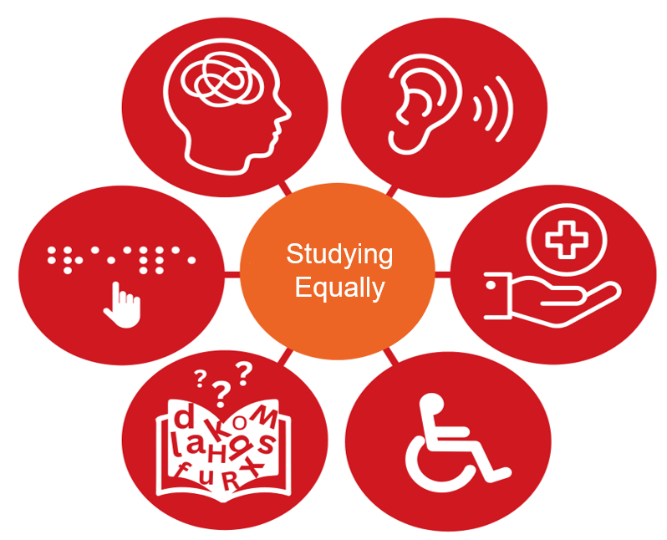
Equal and Accessible Studying at TH Köln
Studying with disabilities, chronic or mental illness? Of course!
Do you have questions about accessible teaching or learning materials, about disadvantage compensation and exams?
Please contact me!
Johanna Schweda
Representative for students with disabilities
Contact and information at:
Link to Studying with Disabilities
Source: ZLE

